Slide 1

Enhancing Visual Inspection with Advanced Anomaly Detection Technologies
Jamal Saeedi
IDSIA, USI-SUPSI

Slide 2
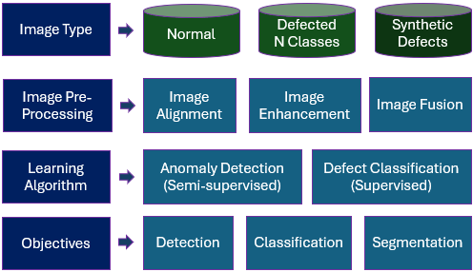
Visual inspection framework

Slide 3

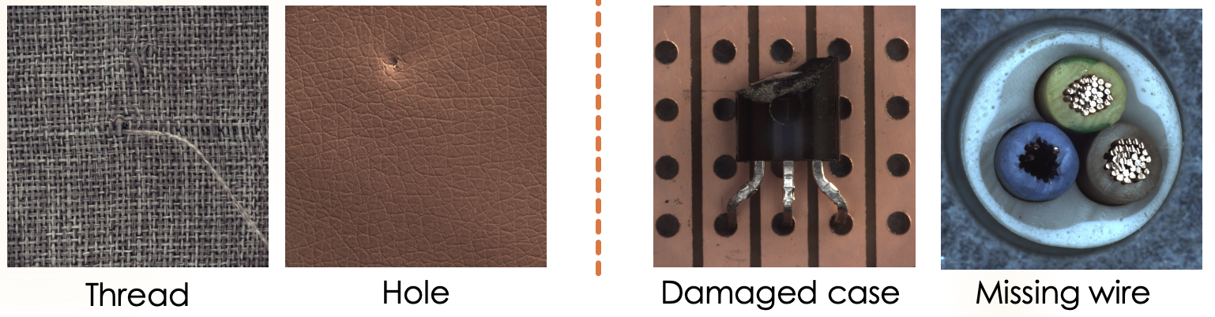
Data types and defects
Normal, defected, and annotated with segmentation map and class label.
Subtle descriptive defects vs. deviations from normality

Slide 4
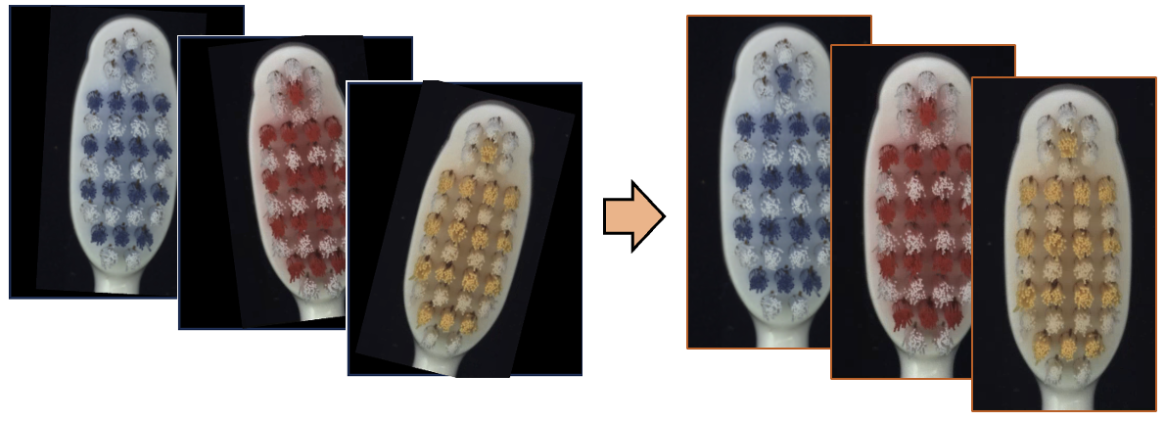
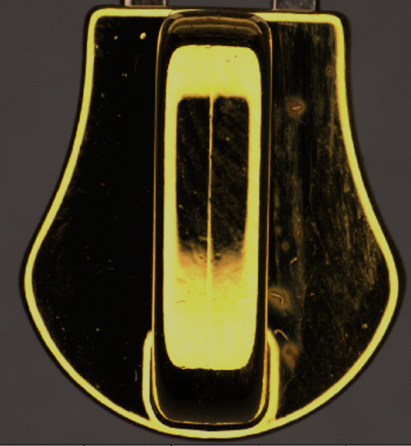
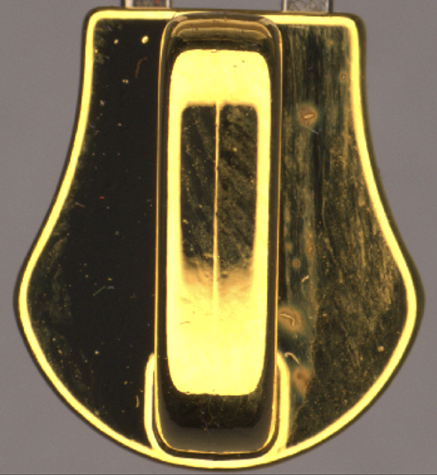
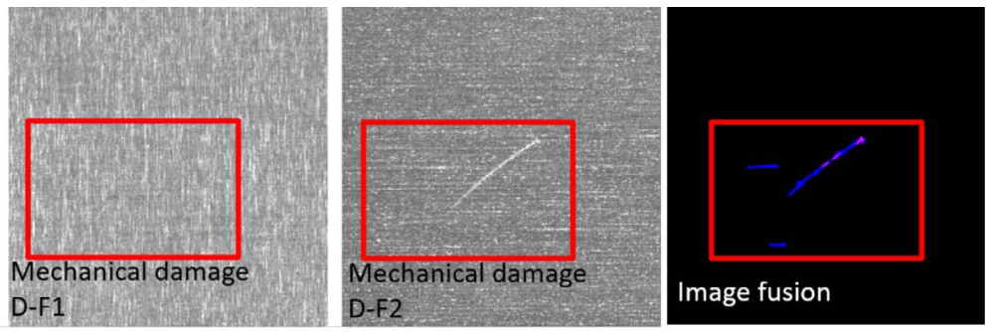
Pre-processing for tailored industrial solutions
Reducing variability, improving sensitivity, and integrating data for comprehensive defect analysis.
Image alignment
Contrast enhancement
Image fusion

Slide 5
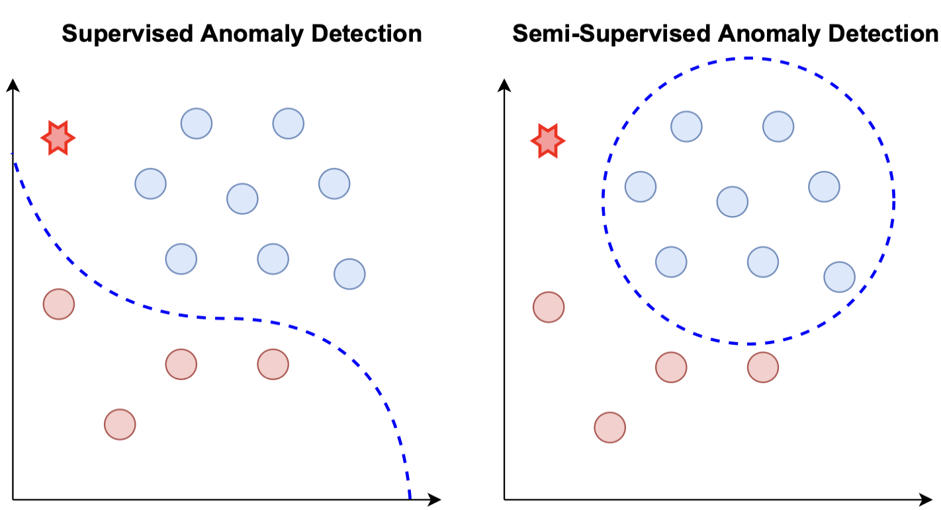

Learning algorithms
Normal samples
Defected samples
Test sample

Slide 6
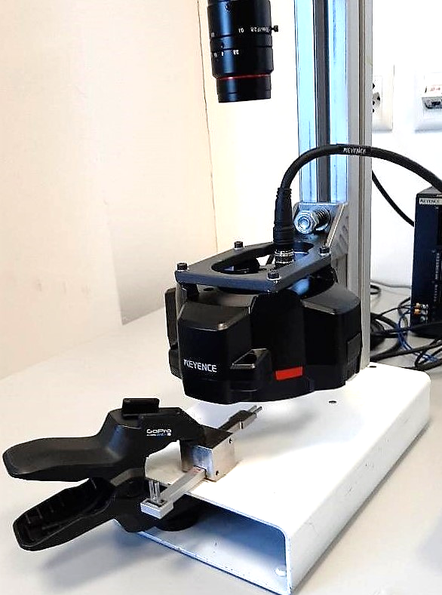
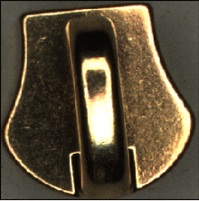
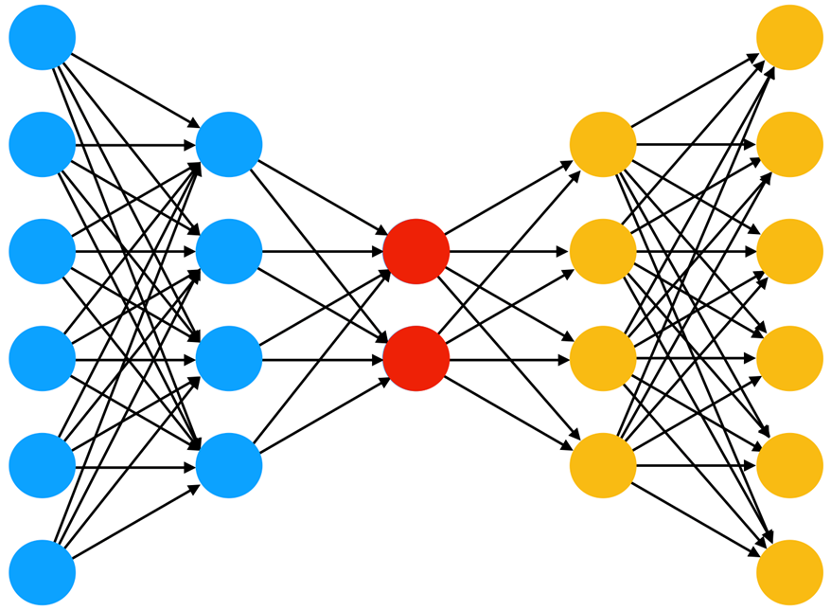
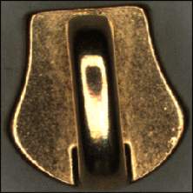
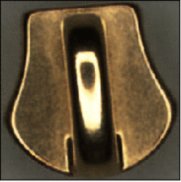
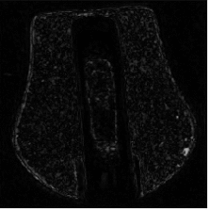
Zipper cursor anomaly detection
Data: zipper cursor images, trained on normal samples.
Algorithm: reconstruction-based method using autoencoder.
Challenges: detecting subtle defects on high resolution images.
Training
Autoencoder
Experimental setup with camera, lighting system and
holder and fixture
Inference
Reconstruction Error
Trained Model

Slide 7
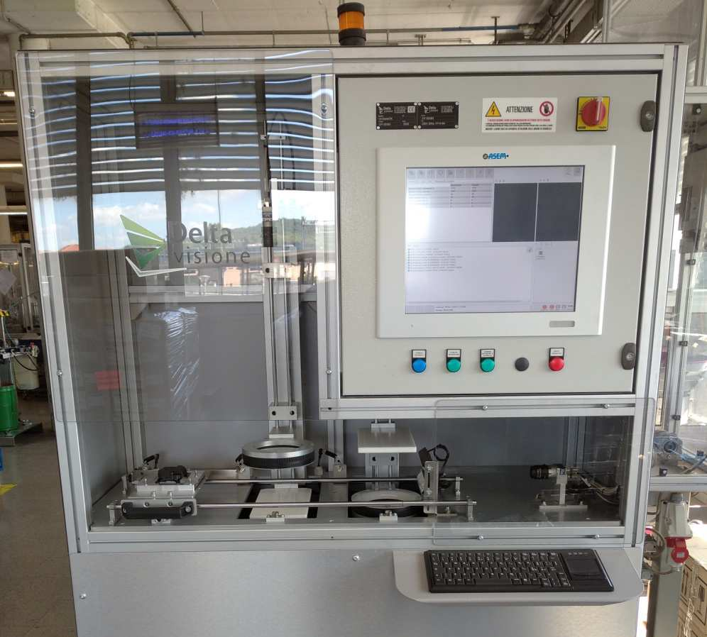
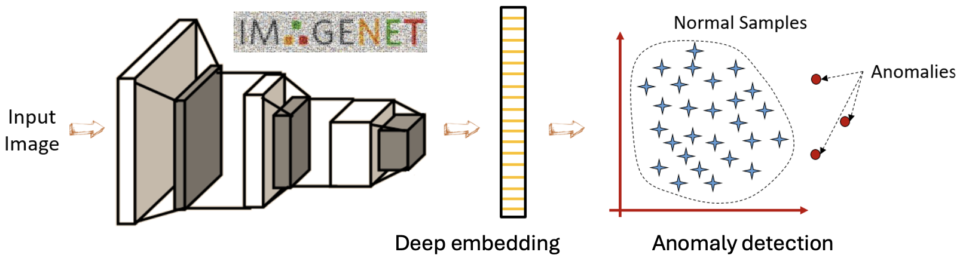
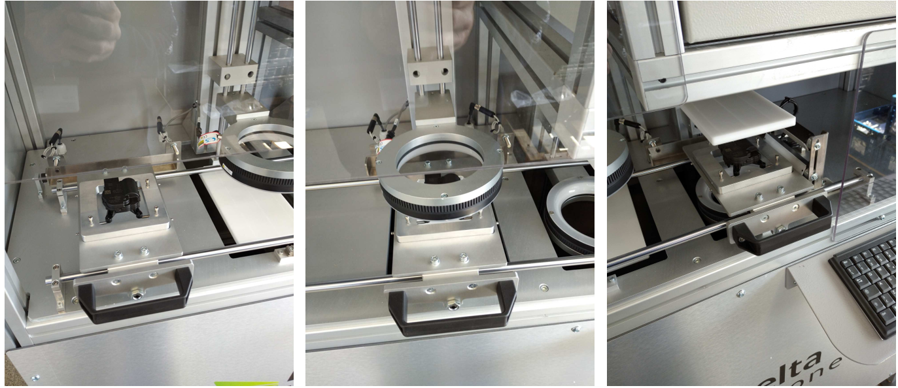
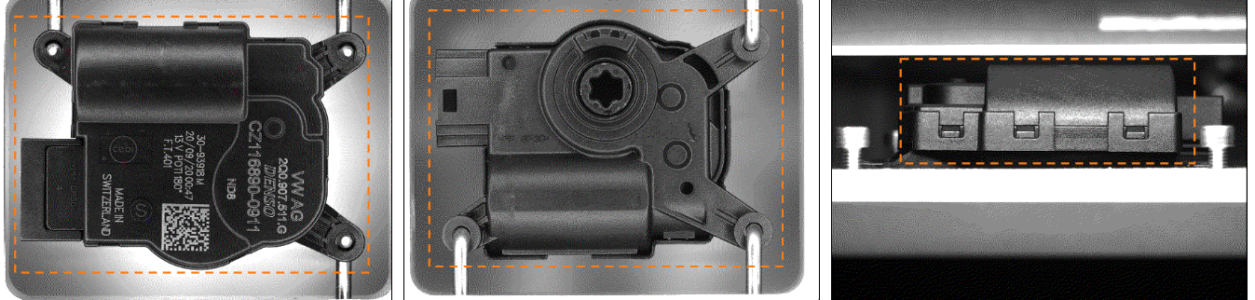
Car HVAC actuator inspection
Data: three views of HVAC actuators images, trained on normal samples.
Algorithm: feature embedding followed by machine learning-based anomaly detection
Challenges: environmental and material changes, low false negative ratio.
Pilot station for image acquisition with 3 cameras plus lighting

Slide 8
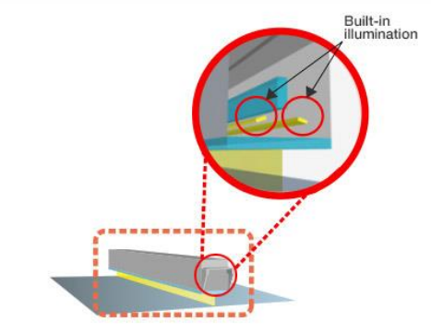
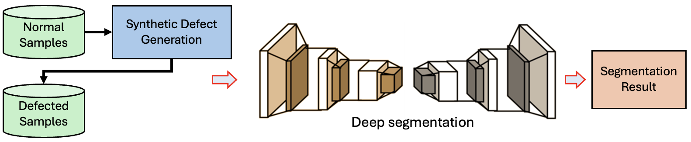
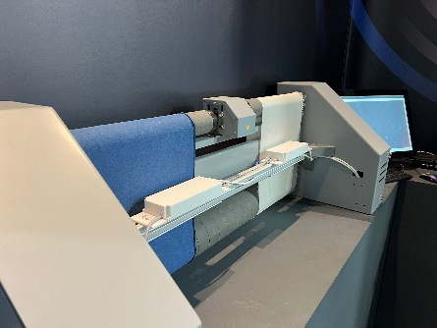
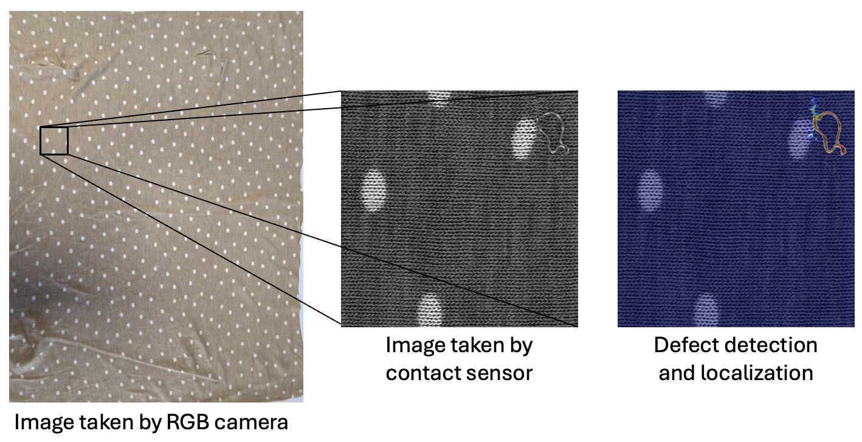
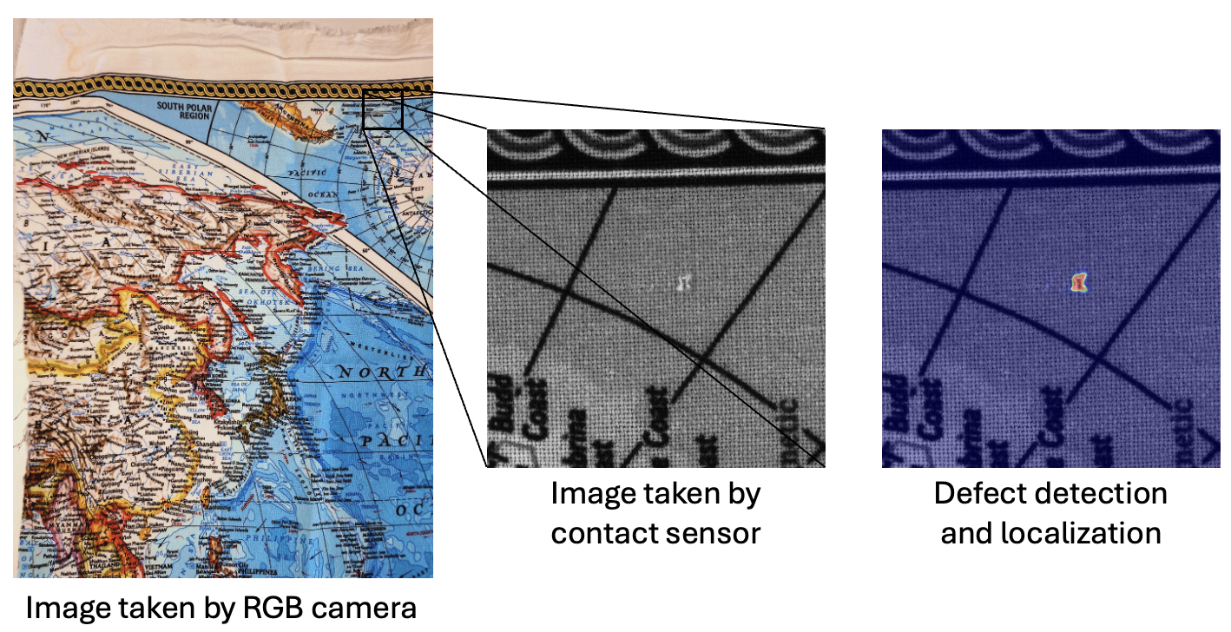
Fabric textile defect detection and localization
Data: fabric textile image, trained on normal and synthetic samples.
Algorithm: generating synthetic defects to train a deep segmentation network.
Challenges: detecting and localizing subtle defects.
Image acquisition setups, contact-based image sensor

Slide 9
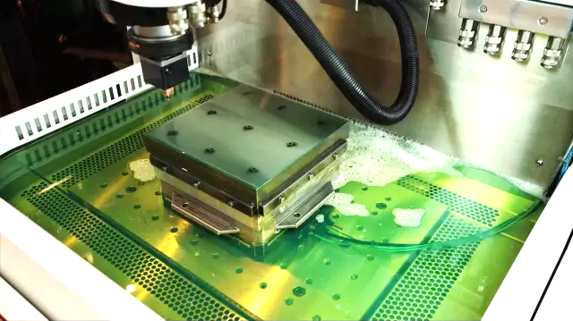
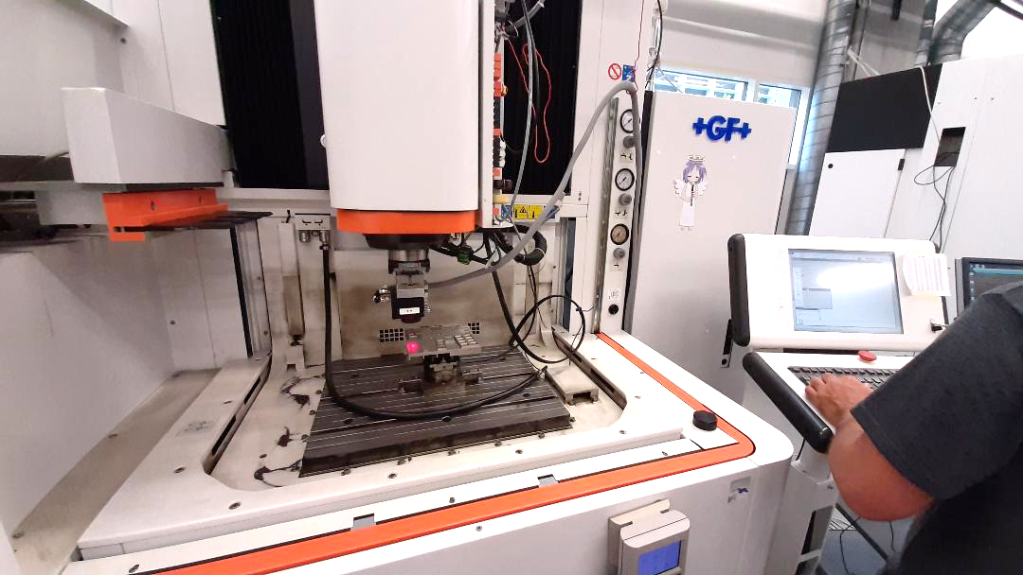
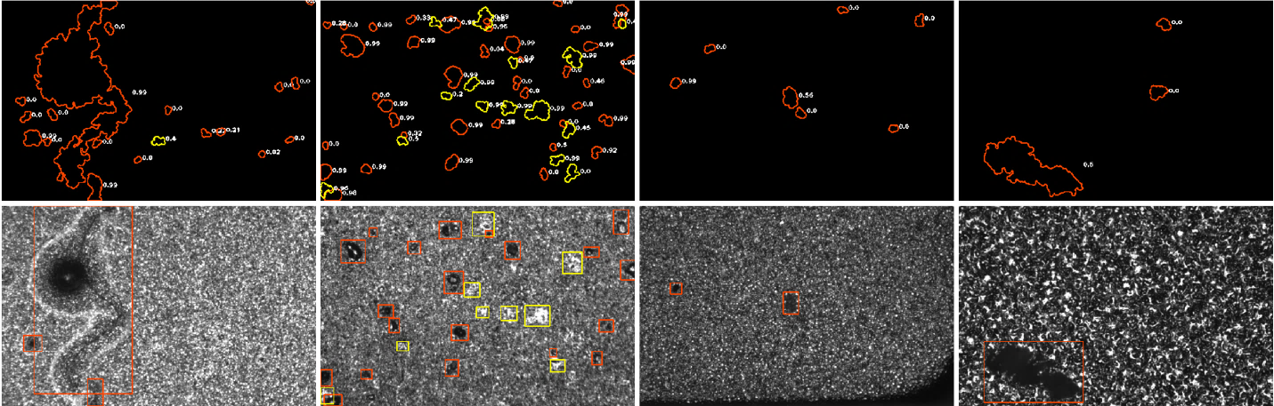
Electrical discharge machined steel inspection
Data: EDA steel surface images, trained on labeled dataset.
Algorithm: Image processing-based region of interest (ROI) selection followed by CNN-based binary classifier.
Challenges: ROI selection and classifying ROIs with different aspect ratios.
+GF+ EDM die-sinking machine and the inspection system
ROI selection and classification

Slide 10
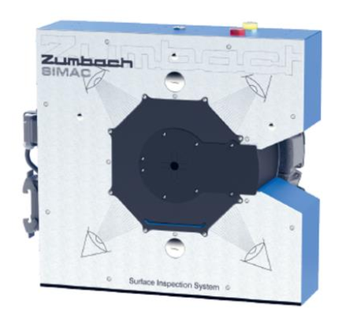
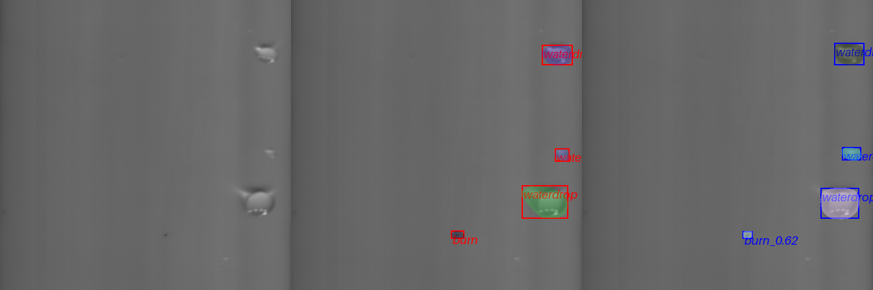
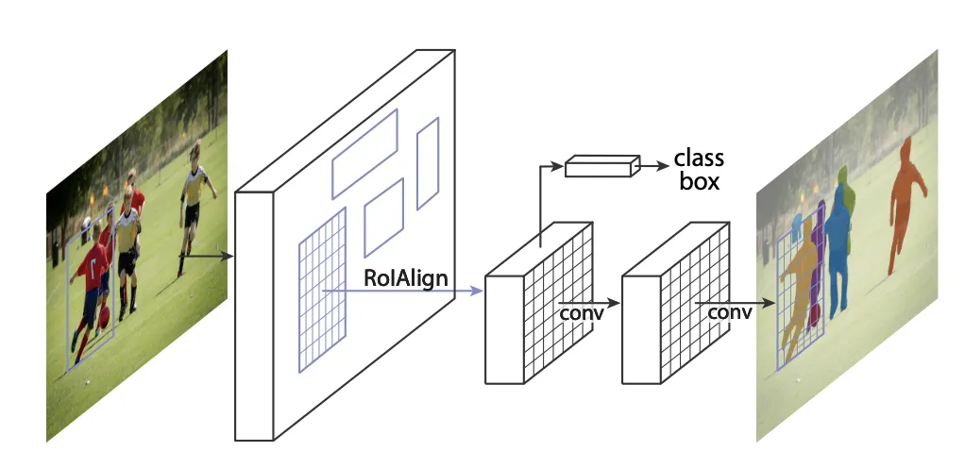
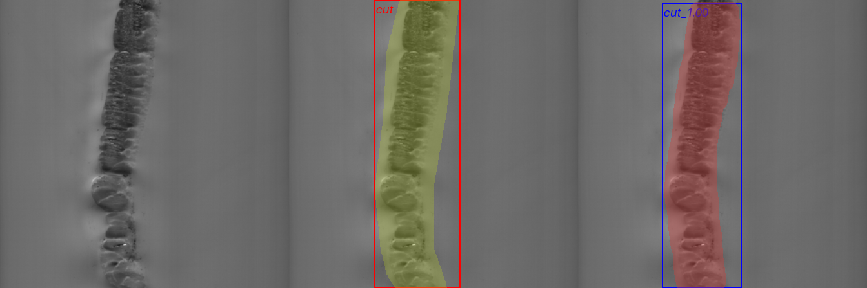
Pipe inspection
Data: pipe surface image, trained on both labeled and annotated data.
Algorithm: anomaly detection followed by instance segmentation.
Challenges: high speed inspection (100 FPS), low false negative ratio, high number of defect classes.
Vision system with 4 line-scan cameras
Instance segmentation architecture

Slide 11

Future works
Hybrid learning methods development
Focus on combining discriminative and generative models
Aimed at enhancing detection of subtle defects and deviations from normality
Collaboration with industrial partners
Exploring new opportunities for collaboration
Providing more efficient and adaptable solutions for the industry

Slide 12

Contact
JAMAL SAEEDI, Ph.D.
Researcher, IDSIA, USI-SUPSI
Email: jamal.saeedi@idsia.ch
Phone: +41768307371
Alessandro Giusti, Ph.D.
Professor, IDSIA, USI-SUPSI
Email: alessandro.giusti@idsia.ch

